Slide 1
Software Defined Network
- What and Why -

Slide 2
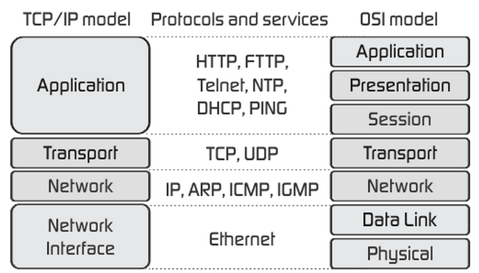
What is SDN?
To Understand we need to study the traditional network first.
There are the layers of the present models:

Slide 3
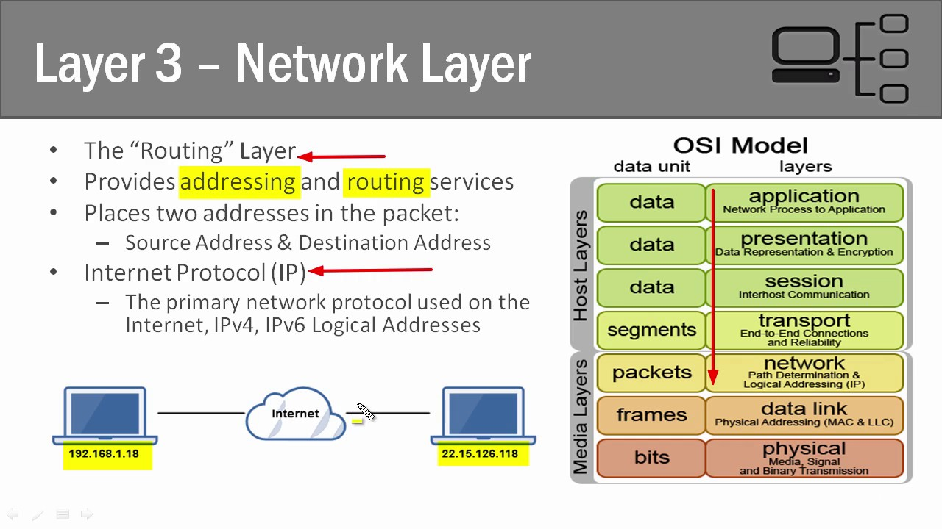
Network Layer

Slide 4
Network Layer Contd..
Each router takes it’s own decision.
Different routing protocols like OSPF and RIP are used to fill the routing table.
Mainly controlled by hardware or devices.
Uses distance or hop count as the metric.

Slide 5
Problems
Each device must have a certain level of intelligence to take decisions.
Device does not have current details of total network.
Only distance or hop count is not a good enough metric for optimization.
Hardware dependant and thus less flexible.
Maintenance and configuration as troublesome.
IoT accommodation and security issues.

Slide 6
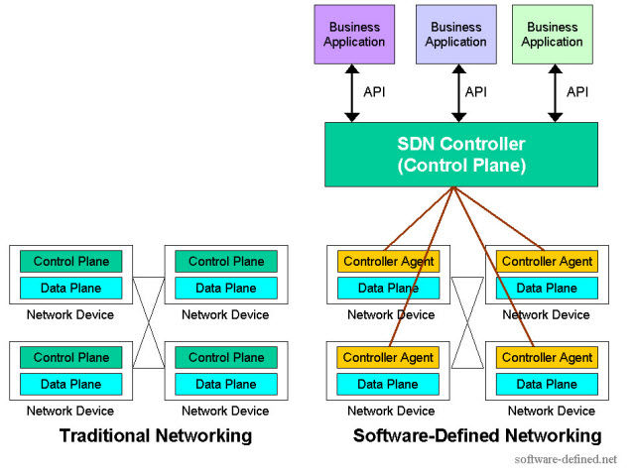
SDN and Traditional

Slide 7
SDN Solutions
Intelligently route traffic from controller.
Simplify information acquisition, information analysis, decision-making, and action implementation process.
Provide visibility of the network resources and management of access based on user, group, device, and application.

Slide 8
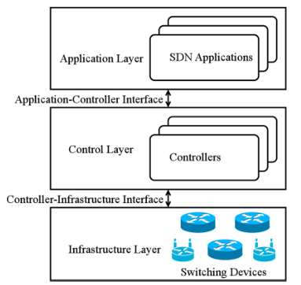
SDN Reference Model

Slide 9
Challenges of SDN
Infrastructure Layer
Control Layer
Application Layer

Slide 10
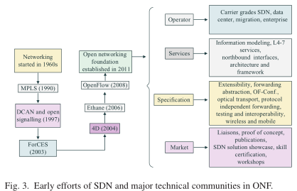
History of SDN

Slide 11
OpenFlow
Developed by researchers to experiment.
Designed by Stanford until 2011.
Then ONF which was formed by Google, Facebook, Cisco system, and Microsoft took to design the standards for OpenFlow.
Also deployed in wireless and telecom.
Introduced 64 OpenFlow products to market.
Flow matching instead of address matching.

Slide 12
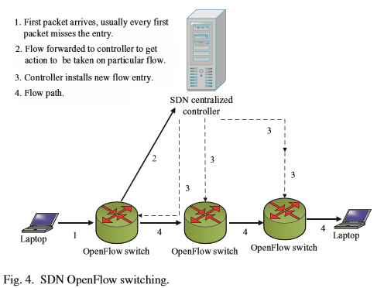
OpenFlow implementation

Slide 13
OpenFlow Simulation Tools
Mininet (python-based open source tool)
W3 (What? Where? When? Problem arises)
troubleshoot bugs in SDN control software
FatTire (declarative language)
Expresses fault-tolerance requirements.
Provide compiler that targets SDN fast-failover mechanism
FS - sdn (also python based)
Larger scale then Mininet
Enables direct use of controller components

Slide 14
Open Research Challenges
Security of SDN
Scalability
Deep Packet Inspection
Packet Drop at AP

